Slide 1
Big Data Analytics Training
Today’s Session: Learn SQL Basics
Trainer: Maryam Baig

Slide 2
Agenda
Introduction
SQL Commands
ERD Diagram
Conditional Clause
Grouping Clause
Aggregation
Joins and their Types

Slide 3
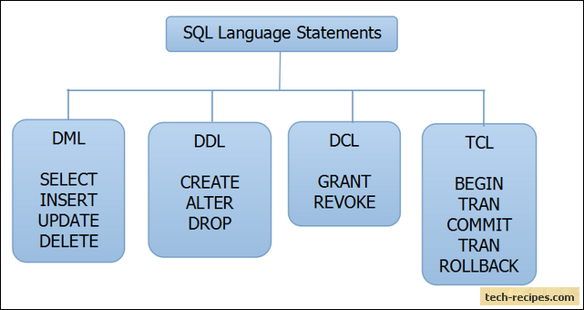
Structures Query Language (SQL)
Declarative query language to,
Create database schemas
Insert
Update
Delete
Query Information etc.
Notes:
https://www.interviewsansar.com/ddl-dml-commands-sql-give-example/

Slide 4
SQL Commands
DDL : Data Definition Language ( Declarations)
DML: Data Manipulation Language ( Code)
DCL: Data Control Language
TCL: Transaction Control Language
Notes:
https://www.interviewsansar.com/ddl-dml-commands-sql-give-example/

Slide 5
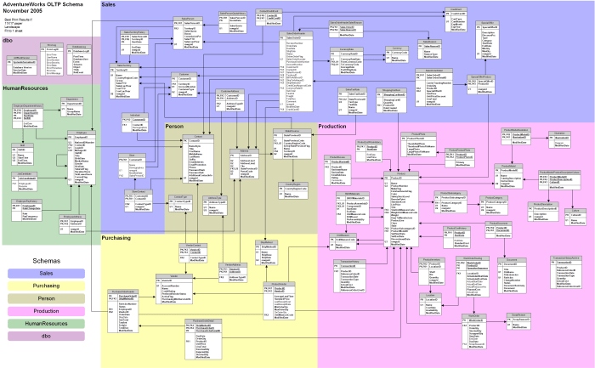
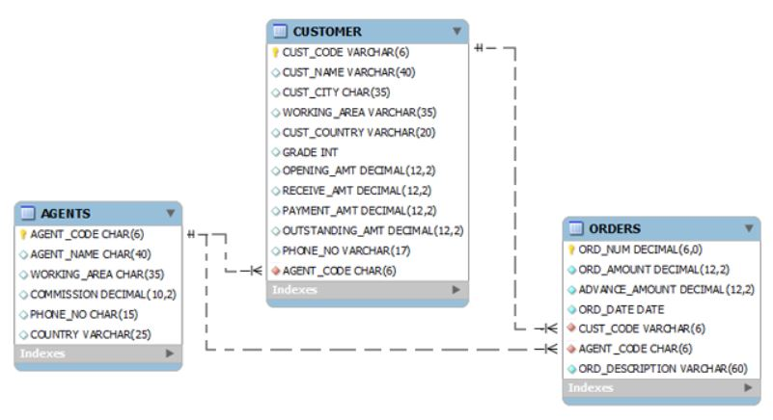
Entity Relationship Diagram (ERD)
Overview of the Database
consisting of,
Entities
Relationships
Notes:
Source: https://www.w3resource.com/sql/sql-table.php

Slide 6
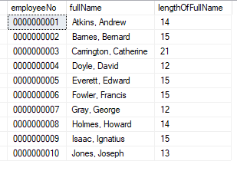
Some frequently used terms in SQL
Column – A finite unit of data. It is represented by one of the data type.
Row – A collection of Columns.
Tables – Collection of rows.
Database – Collection of tables and other objects.
Notes:
https://www.w3schools.com/sql/sql_datatypes.asp

Slide 7
Select Command
SELECT Command is used to retrieve data
Syntax: SELECT <Column list> from <Table>
Get all data in table :
SELECT * from <Table>
Example: SELECT * from AGENTS;
Get few Columns:
SELECT <col1,col2> from <Table>
Example: SELECT AGENT_CODE,AGENT_NAME from AGENTS;

Slide 8
Select Command
Get few Rows:
keyword: TOP
Syntax:
SELECT TOP <Number or percent> * from <Table>
Example: SELECT TOP (10) * from AGENTS;

Slide 9
Remove Duplicates
Get Unique Rows:
keyword: DISTINCT
Syntax:
SELECT DISTINCT <Column list> from <Table>
Example: SELECT DISTINCT CUST_CODE from AGENTS;

Slide 10
Conditional Clause
WHERE Clause is used to filter the result using some condition
Syntax: SELECT <Column list> from <Table> WHERE <condition>
Conditions Syntax:
<Column that has be to compared> <Operator> <Value with which comparison has to be done>
Example: select * from AGENTS where AGENT_CODE=‘A001’;

Slide 11
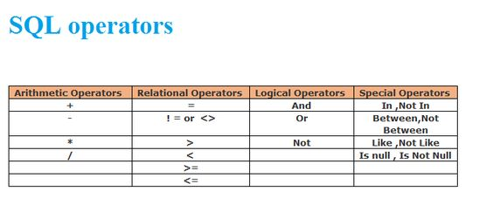
List of Operators
Notes:
https://www.tutorialspoint.com/sql/sql-operators.htm

Slide 12
Sorting Results
Order by Clause is used to sort data in ascending and descending order
Syntax: SELECT <Columns> from <Table> ORDER BY <columns> {ASC/DESC}
Or
SELECT <Columns> from <Table> WHERE <condition>
ORDER BY <columns> {ASC/DESC}
Example: select * from AGENTS ORDER BY AGENT_CODE
Notes:
Note: if not specified sort in ascending order by default

Slide 13
Group by Clause
GROUP BY is the clause used to group data based on the given criteria.
Syntax: SELECT <Columns> FROM <table Name> GROUP BY <Columns>
Example:
SELECT AGENT_NAME,WORKING_AREA from AGENTS group by WORKING_AREA,AGENT_NAME;
Notes:
Common mistake: http://learnsqltips.blogspot.com/2012/04/group-by-errors-in-sql-server.html

Slide 14
Aggregate Functions
An aggregate function allows you to perform a calculation on a set of values to return a single scalar value. We often use aggregate functions with the GROUP BY and HAVING clauses of the SELECT statement.
Syntax: SELECT <aggregate_function>(<column>) FROM <table>
Example: SELECT count(*) from AGENTS;

Slide 15
Some Aggregate Functions in SQL
The following are the most commonly used SQL aggregate functions:
AVG : calculates the average of a set of values.
COUNT: counts rows in a specified table or view.
MIN: gets the minimum value in a set of values.
MAX: gets the maximum value in a set of values.
SUM: calculates the sum of values.
Notes:
http://learnsqltips.blogspot.com/2012/04/aggregate-functions-in-sql-server.html

Slide 16
HAVING Clause
HAVING Clause is used only with the SELECT Command to filter the result set that is obtained by GROUP BY Command.
Syntax: SELECT <Column list> FROM <Table Name> GROUP BY < Column List> HAVING <search condition>
EXAMPLE: select AGENT_NAME,WORKING_AREA from AGENTS group by WORKING_AREA,AGENT_NAME having WORKING_AREA=‘London’
OR
select WORKING_AREA,count(AGENT_NAME) from AGENTS group by WORKING_AREA having count(AGENT_NAME)>1

Slide 17
JOINS
JOIN is the keyword or Command which is used to link 2 or more tables to retrieve data.
Syntax: SELECT <columns> FROM <table1> JOIN <table2> ON <table1.id>=<table2.id>
Example: select CUST_CODE,CUST_NAME, c.AGENT_CODE, AGENT_NAME from CUSTOMER as c join AGENTS as a on c.AGENT_CODE=a.AGENT_CODE
Notes:
Self join vs Cross Join

Slide 18

Types of Joins

Slide 19
Resources
W3schools
w3resource
Vertabelo Academy

Slide 20
THANKS!

